Slide 1

SpaceX Launch Success Prediction:
A Data-Driven Exploration Journey
Juan Barca
https://github.com/xanvideira/SpaceXan
September 2025 DISCLAIMER: I thought I hade more time to ellaborate this report

Slide 2
Outline
Executive Summary
Introduction
Methodology
Results
Conclusion
Appendix

Slide 3
Executive Summary
Summary of methodologies We used a comprehensive approach including data collection via the SpaceX API and web scraping, data wrangling, exploratory data analysis using SQL and visualizations, and predictive modeling.
Summary of all results Our analysis successfully identified key factors influencing launch success. The Decision Tree Classifier proved to be the most effective model, achieving 88% accuracy in predicting successful first-stage landings.

Slide 4
Introduction
Project background and context SpaceX's Falcon 9's reusability is a key competitive advantage, significantly reducing launch costs. Accurately predicting the success of first-stage landings is crucial for maximizing this benefit.
Problems we want to find answers
What factors are most correlated with a successful landing?
Can we create a model to accurately predict if the first stage will land successfully?
What is the best model for this prediction task?

Slide 5

Section 1

Slide 6
Methodology
Executive Summary
Data collection methodology: Data was collected from the SpaceX API and by scraping Wikipedia.
Data wrangling: Missing values were handled, and new features were engineered.
Exploratory data analysis (EDA) using visualization and SQL: We used SQL queries and visualizations to uncover key patterns and correlations in the data.
Interactive visual analytics using Folium and Plotly Dash: An interactive dashboard was built to explore data relationships and geographical insights.
Predictive analysis using classification models: Multiple classification models were trained, tuned, and evaluated to find the most accurate predictor.
6

Slide 7
Data Collection
Process: We systematically collected data from two primary sources to build a comprehensive historical record of Falcon 9 launches. This provided a robust foundation for our analysis.
Key Stages / Tools:
SpaceX API for structured, programmatic data.
Web Scraping for historical records from Wikipedia.
Data fusion and cleaning to create a single, unified dataset.
7

Slide 8
Data Collection – SpaceX API
Process: The SpaceX REST API was used to retrieve a rich dataset of launch records. The data includes details like launch date, location, and key mission outcomes.
Flowchart: The process began with an API request, followed by parsing the JSON response and extracting key data points, which were then stored in a structured format.
Reference: https://github.com/xanvideira/SpaceXan/blob/main/1.- jupyter-labs-spacex-data-collection-api.-COMPLETED.ipynb
8

Slide 9
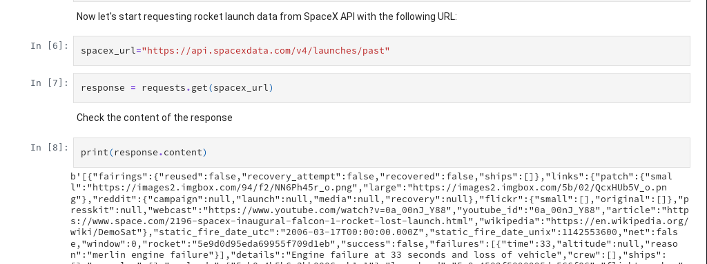
Data Collection – SpaceX API
Fig. 1: Checking SpaceX REST API
9

Slide 10
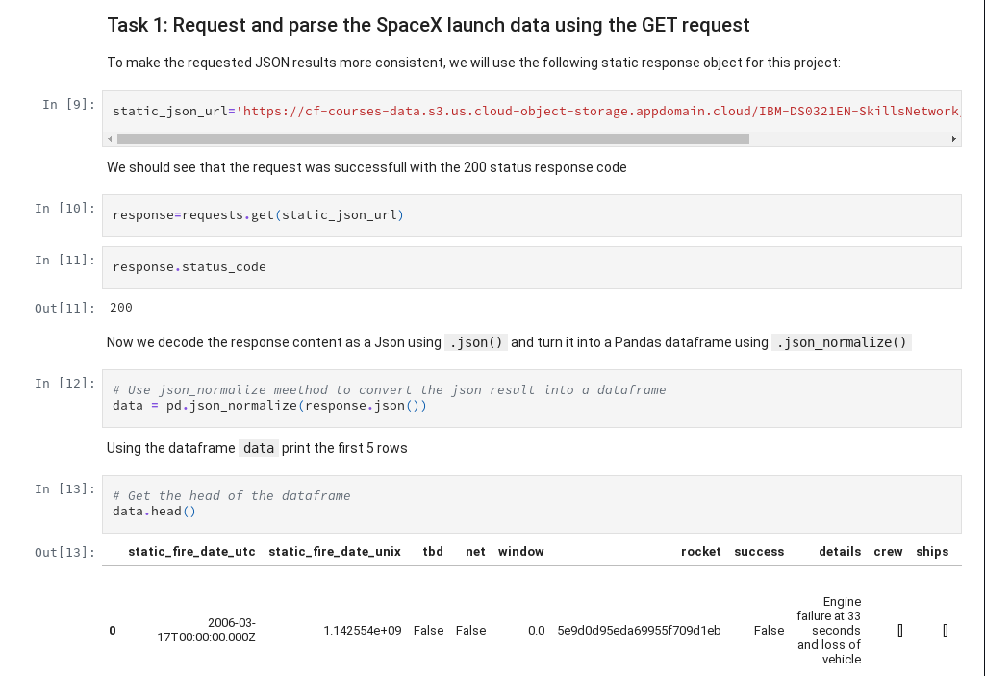
Data Collection – SpaceX API
Fig. 2: Request and parse the SpaceX launch data using the GET request
10

Slide 11
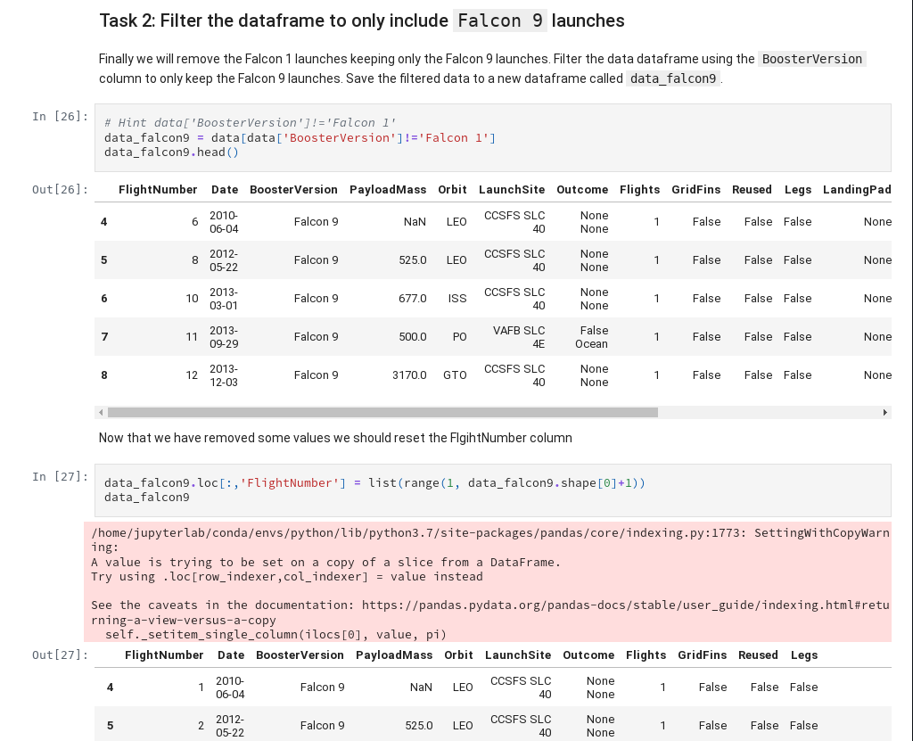
Data Collection – SpaceX API
Fig. 3: Filter the dataframe to only include Falcon 9 launches
11

Slide 12
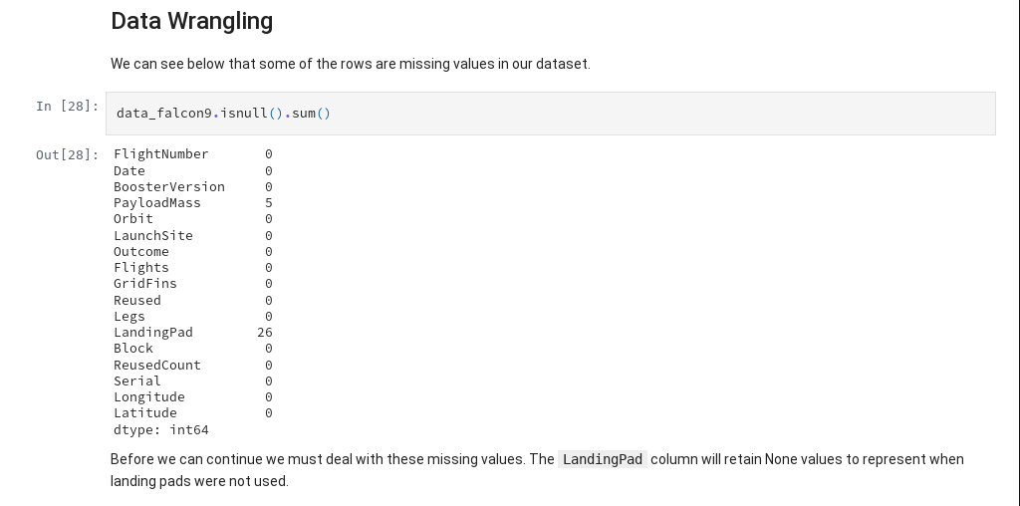
Data Collection – SpaceX API
Fig. 4: Data Wrangling
12

Slide 13
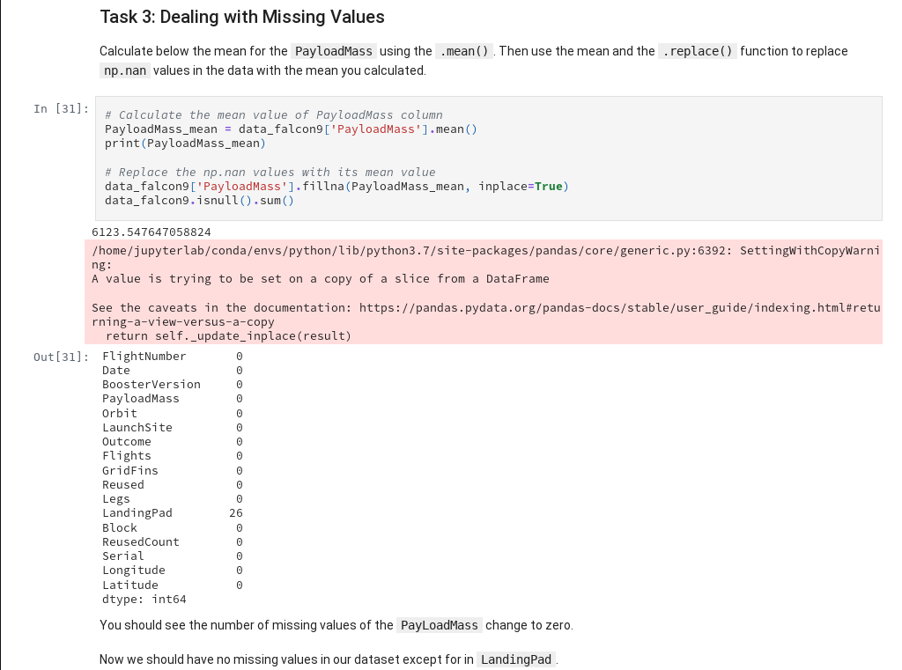
Data Collection – SpaceX API
Fig. 5: Dealing with Missing Values
13

Slide 14
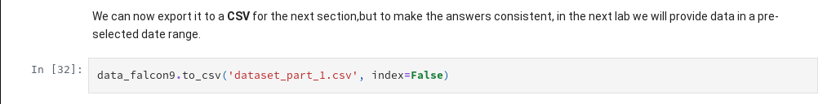
Data Collection – SpaceX API
Fig. 6: Exporting SpaceX API Dataset to CSV file
14

Slide 15
Data Collection - Scraping
Process: The “List of Falcon 9 and Falcon Heavy launches” Wikipedia page was scraped using Python libraries. This was crucial to supplement the API data with additional historical information and details not available programmatically.
Flowchart: The web scraping process involved making an HTTP request to the Wikipedia URL, using a parser to locate the relevant HTML tables, and then extracting and cleaning the table data into a pandas DataFrame.
Reference: https://github.com/xanvideira/SpaceXan/blob/main/2.- jupyter-labs-webscraping-COMPLETED.ipynb
15

Slide 16
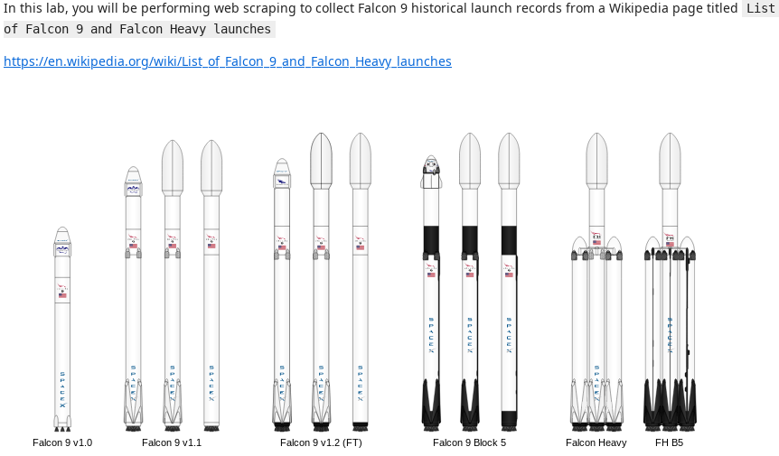
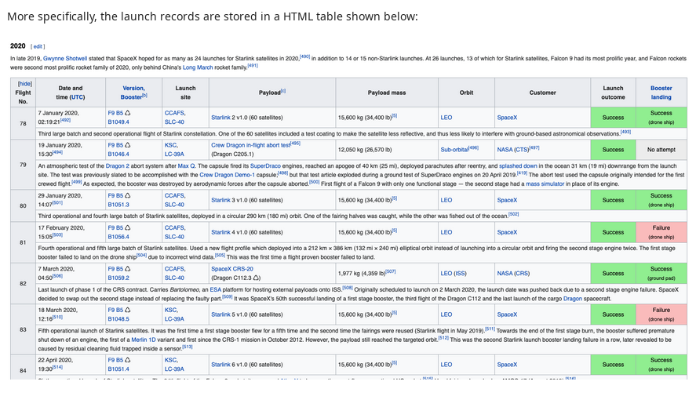
Data Collection - Scraping
Fig. 7: Sample illustration and table fron Wikipedia page (extracted from Notebook)
16

Slide 17
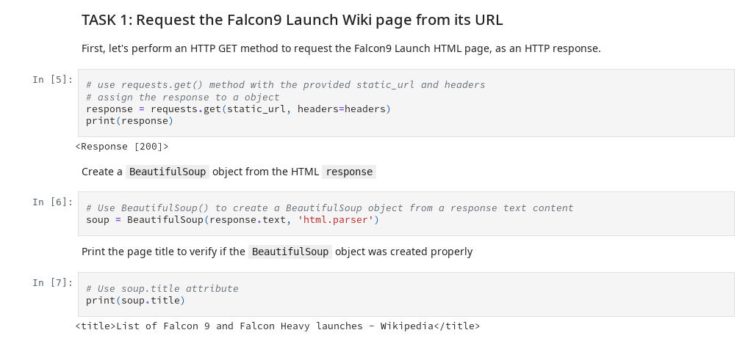
Data Collection - Scraping
Fig. 8: Request the Falcon9 Launch Wiki page from its URL
17

Slide 18
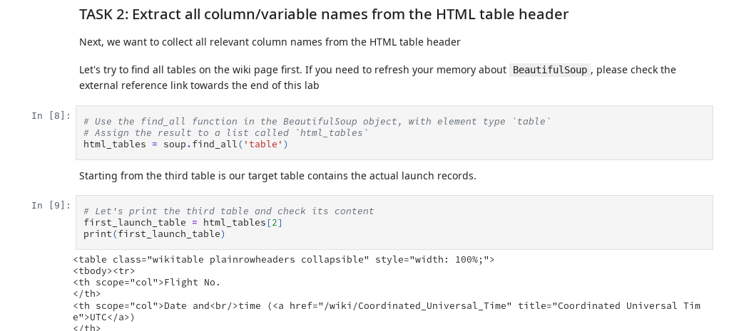
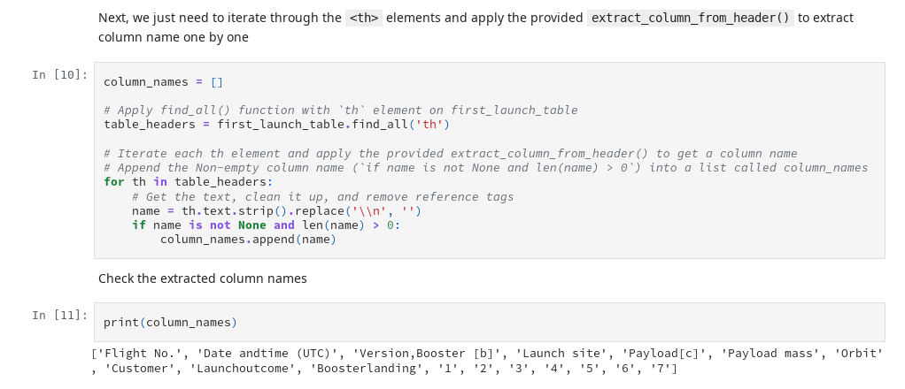
Data Collection - Scraping
Fig. 9: Extract all column/variable names from the HTML table header
18

Slide 19
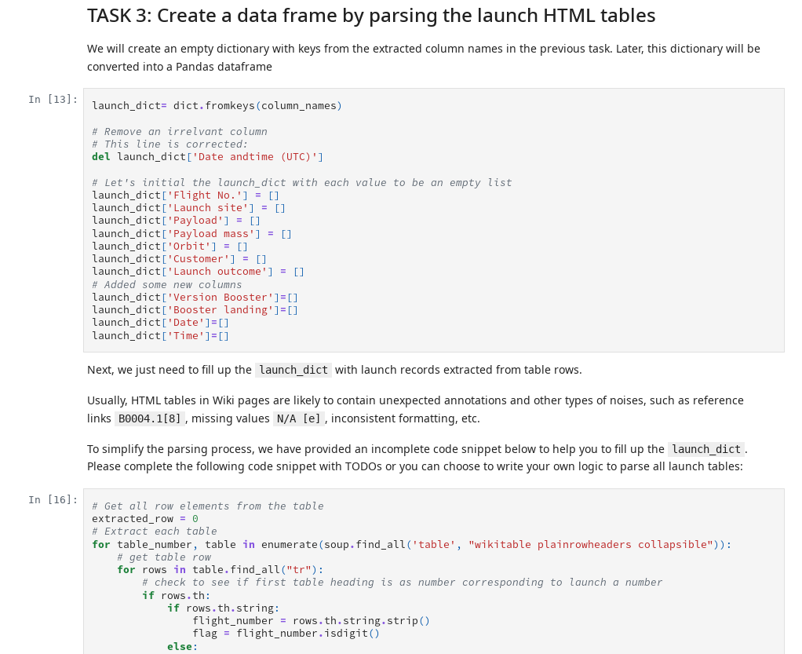
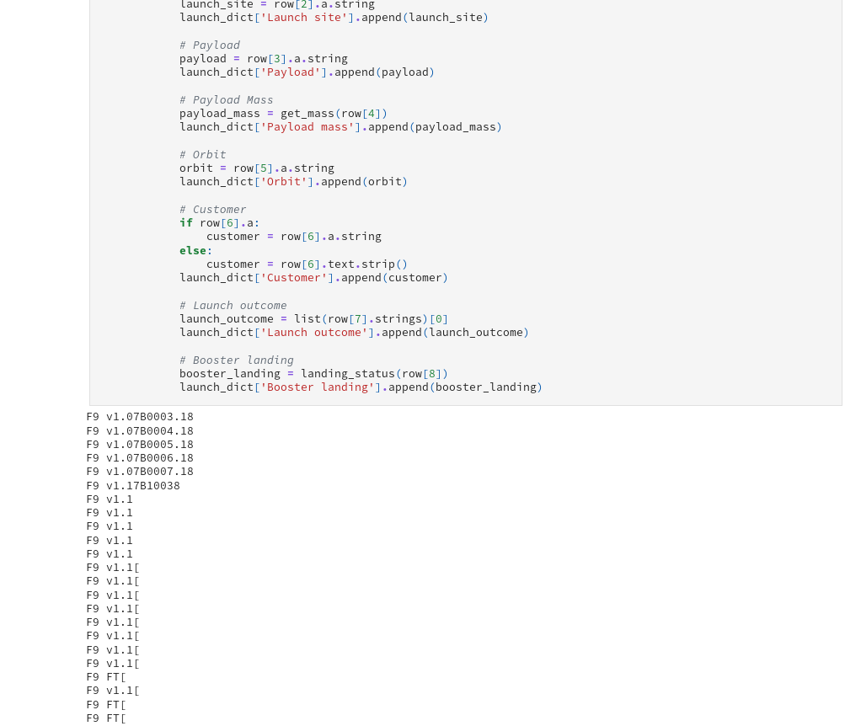
Data Collection - Scraping
Fig. 10.1: Create a data frame by parsing the launch HTML tables (Task 3)
19

Slide 20
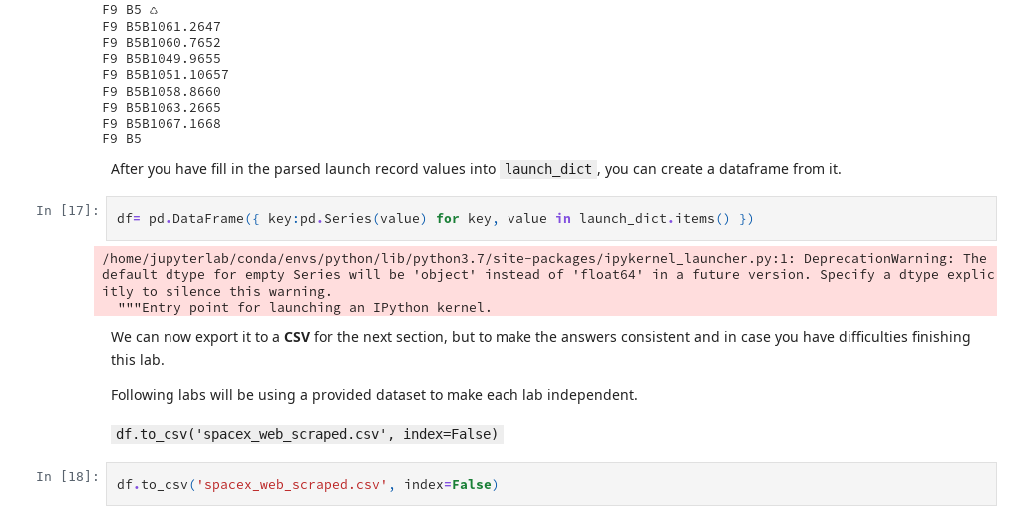
Data Collection - Scraping
Fig. 10.2: Export data after parsing the launch HTML tables (Task 3)
20

Slide 21
Data Wrangling
Process: After collecting the raw data, extensive data wrangling was performed to prepare it for analysis.
Steps:
Handling Missing Values: Missing or inconsistent data points were addressed.
Feature Engineering: New variables were created, such as one-hot encoding for categorical features like LaunchSite and Orbit, to make them suitable for machine learning models.
Data Cleaning: Data types were converted and columns were standardized.
Reference: https://github.com/xanvideira/SpaceXan/blob/main/3.- labs-jupyter-spacex-Data wrangling-COMPLETED.ipynb
21

Slide 22
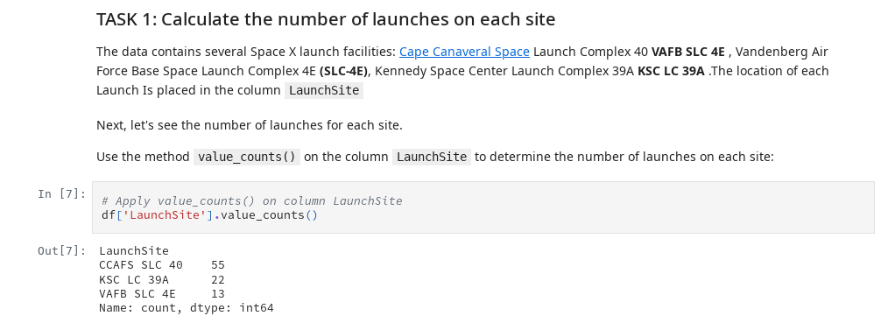
Data Wrangling
Fig. 11: Calculate the number of launches on each site
22

Slide 23
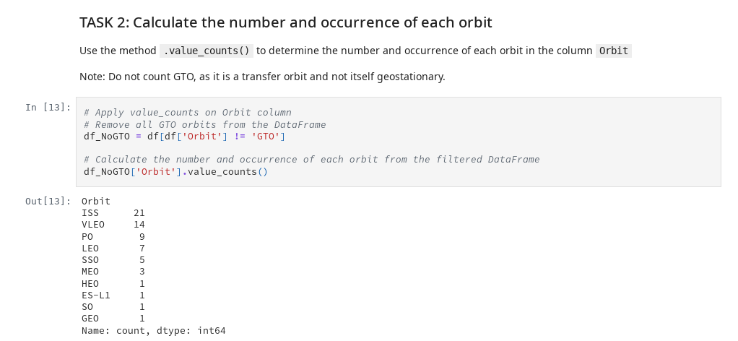
Data Wrangling
Fig. 12: Calculate the number and occurrence of each orbit
23

Slide 24
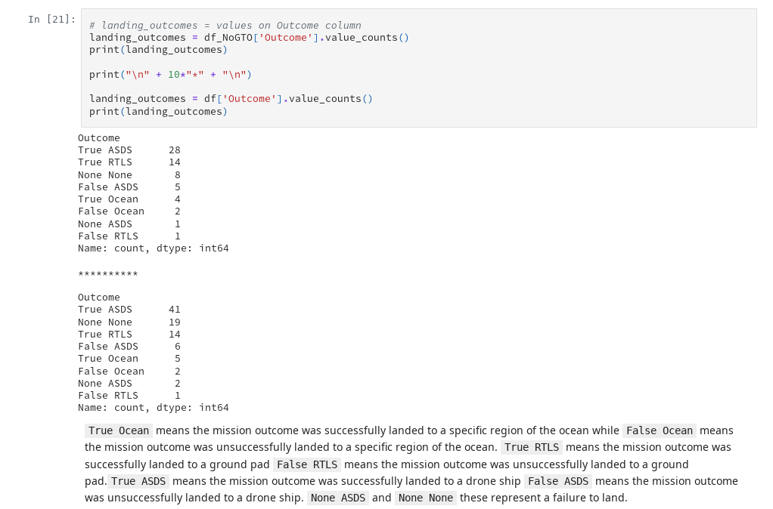
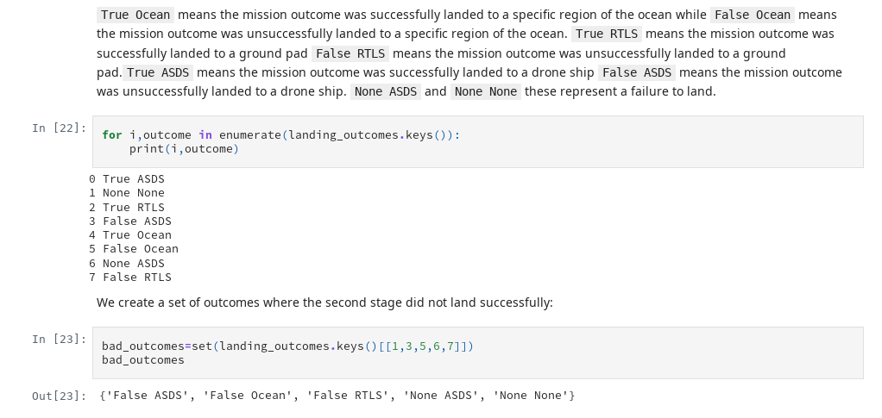
Data Wrangling
Fig. 13: Calculate the number and occurence of mission outcome of the orbits
24

Slide 25
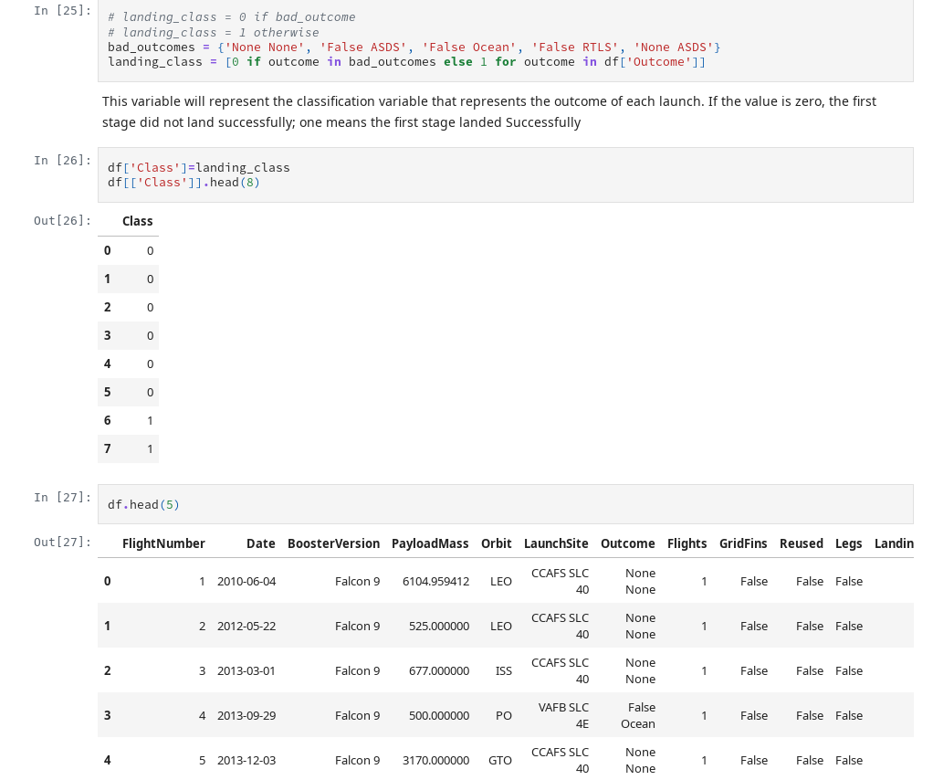
Data Wrangling
Fig. 14: Create a landing outcome label from Outcome column
25

Slide 26
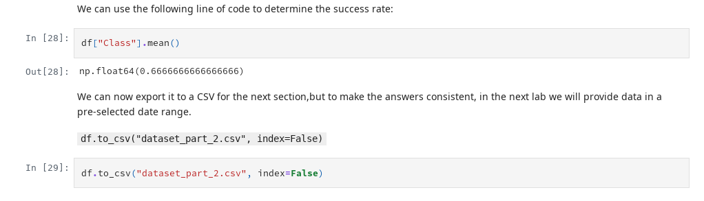
Data Wrangling
Fig. 14: Exporting dataset
26

Slide 27
EDA with Data Visualization
Key Findings: Visualizations were used to bring the data to life and reveal trends that are difficult to see in raw data.
Examples:
Scatter Plots: Showed a clear trend: as Payload Mass (kg) increases, the success rate of the Booster Version changes. This suggests payload is a significant factor.
Bar Charts: Confirmed that certain launch sites have a much higher success rate than others.
Line plots: Showed increasing success over the years (technology is getting better as more failure data is acquired and errors corrected).
27

Slide 28
EDA with SQL
Performed SQL queries (1/2):
"SELECT DISTINCT \"Launch_Site\" FROM SPACEXTBL" (names of the unique launch sites in the space mission)
"SELECT * FROM SPACEXTBL WHERE \"Launch_Site\" LIKE 'CCA%' LIMIT 5" (5 records where launch sites begin with the string 'CCA')
"SELECT SUM(\"PAYLOAD_MASS__KG_\") FROM SPACEXTBL WHERE Customer = 'NASA (CRS)'" (total payload mass carried by boosters launched by NASA (CRS))
"SELECT AVG(\"PAYLOAD_MASS__KG_\") FROM SPACEXTBL WHERE \"Booster_Version\" = 'F9 v1.1'" (average payload mass carried by booster version F9 v1.1)
"SELECT MIN(\"Date\") FROM SPACEXTBL WHERE \"Landing_Outcome\" = 'Success (ground pad)'" (date when 1st succesful landing outcome in ground pad was achieved)
GitHub URL: https://github.com/xanvideira/SpaceXan/blob/main/4.- jupyter-labs-eda-sql-coursera_sqllite-COMPLETED.ipynb
28

Slide 29
EDA with SQL
Performed SQL queries (2/2):
"SELECT DISTINCT \"Booster_Version\" FROM SPACEXTBL WHERE \"Landing_Outcome\" = 'Success (drone ship)' AND \"PAYLOAD_MASS__KG_\" BETWEEN 4000 AND 6000" (names of the boosters which had success in drone ship and have payload mass greater than 4000 but less than 6000)
"SELECT \"Mission_Outcome\", COUNT(\"Mission_Outcome\") FROM SPACEXTBL GROUP BY \"Mission_Outcome\"" (total number of successful and failure mission outcomes)
"SELECT DISTINCT \"Booster_Version\" FROM SPACEXTBL WHERE \"PAYLOAD_MASS__KG_\" = (SELECT MAX(\"PAYLOAD_MASS__KG_\") FROM SPACEXTBL)" (booster_versions that have carried the maximum payload mass)
"SELECT substr(Date, 6, 2) AS Month, \"Landing_Outcome\", \"Booster_Version\", \"Launch_Site\" FROM SPACEXTBL WHERE \"Landing_Outcome\" = 'Failure (drone ship)' AND substr(Date, 0, 5) = '2015'" (display records with month names, failure landing_outcomes in drone ship ,booster versions, launch_site for the months in year 2015)
"SELECT \"Landing_Outcome\", COUNT(\"Landing_Outcome\") AS OutcomeCount FROM SPACEXTBL WHERE \"Date\" BETWEEN '2010-06-04' AND '2017-03-20' GROUP BY \"Landing_Outcome\" ORDER BY OutcomeCount DESC" (rank the count of landing outcomes (such as Failure (drone ship) or Success (ground pad)) between the date 2010-06-04 and 2017-03-20, in descending order.)
29

Slide 30
EDA with SQL: Conclusions (1/3)
Launch Site Operations:
SpaceX operates from four distinct launch sites: CCAFS LC-40, VAFB SLC-4E, KSC LC-39A, and CCAFS SLC-40
CCAFS LC-40 appears to be heavily utilized across the mission timeline
Payload and Performance Metrics:
NASA CRS missions carried a total payload mass of 45,596 kg, demonstrating SpaceX's significant cargo capacity for ISS resupply
The F9 v1.1 booster version carried an average payload of 2,928.4 kg per mission
Multiple F9 B5 variants (including B1048.4, B1049.4, B1051.3, etc.) achieved the maximum payload capacity, showing the maturity of the Block 5 design
30

Slide 31
EDA with SQL: Conclusions (2/3)
Mission Success Rates:
The data shows overwhelmingly successful missions: 98 "Success" outcomes plus 1 additional "Success" and 1 "Success (payload status unclear)" versus only 1 "Failure (in flight)"
This represents approximately 99% mission success rate, demonstrating SpaceX's operational reliability
Landing Technology Evolution:
The first successful ground pad landing occurred on December 22, 2015, marking a crucial milestone in reusability
Between 2010-2017, landing outcomes varied significantly: 10 "No attempt" (early missions), 5 each of "Success (drone ship)" and "Failure (drone ship)", and 3 "Success (ground pad)"
This progression shows SpaceX's iterative approach to developing landing capabilities
31

Slide 32
EDA with SQL: Conclusions (3/3)
Reusability Development Timeline:
2015 data shows early drone ship landing attempts with 2 failures (January and April), indicating the experimental phase of recovery technology
The transition from "No attempt" to active landing recovery efforts demonstrates SpaceX's commitment to reusability
Technical Achievements:
Four boosters successfully landed on drone ships with payloads between 4-6 tons (F9 FT B1022, B1026, B1021.2, B1031.2), proving the viability of recovery even with substantial cargo
This analysis reveals SpaceX's evolution from an experimental launch provider to a highly reliable operator with successful reusability technology
32

Slide 33
Build an Interactive Map with Folium (1/2)
Markers for Launch Sites (folium.Marker): To visualize the geographic distribution of SpaceX launch sites and easily identify them on the map.
Circles Around Launch Sites (folium.Circle): To highlight the exact location and area around each launch site for better visibility.
Custom Text Labels (folium.DivIcon): To label locations clearly without requiring the user to click on popups.
Markers for Launch Outcomes (folium.Marker): To analyze launch history visually, showing both the location and success/failure of past missions.
GitHub URL: https://github.com/xanvideira/SpaceXan/blob/main/6.- lab_jupyter_launch_site_location-COMPLETED.ipynb
33

Slide 34
Build an Interactive Map with Folium (2/2)
Marker Clusters (MarkerCluster): To avoid cluttering the map with too many overlapping markers, while still allowing interactive exploration of individual launches.
Distance Markers and Lines (folium.Marker objects, DivIcon labels and folium.Polyline objects): To evaluate geographic constraints and accessibility of launch sites (e.g., distance to transport links and populated areas).
NASA Johnson Space Center Marker and Circle (folium.Circle and folium.Marker): To provide geographic context by marking NASA’s key facility in relation to the launch sites.
We built an interactive folium map with markers, circles, labels, clusters, and polylines to locate SpaceX launch sites, visualize success/failure of launches, and measure distances to nearby infrastructure and landmarks.
This helped analyze the suitability and accessibility of different launch locations.
34

Slide 35
Build a Dashboard with Plotly Dash
Plots/Graphs and Interactions Added:
Dropdown Menu for Launch Site Selection
Pie Chart: Total Successful Launches
Range Slider for Payload Mass
Scatter Plot: Correlation Between Payload and Launch Success
Why These Plots and Interactions Were Added?:
User-Centric Exploration: The dashboard is designed to be interactive, allowing users to drill down into the data based on their interests (e.g., by site or payload range).
Data-Driven Insights: The pie chart and scatter plot provide visual answers to key questions (“Which launch sites are most successful?”, “How does payload mass impact launch success?” or “Are there differences in performance between booster versions?”)
Flexibility: The dropdown and slider make the dashboard adaptable to different analytical needs, from high-level overviews to granular investigations.
GitHub URL: https://github.com/xanvideira/SpaceXan/blob/main/spacex-dash-app-COMPLETED.py
35

Slide 36
Build a Dashboard with Plotly Dash (detail: 1/2)
Dropdown Menu for Launch Site Selection
Interaction: Users can select a specific launch site (e.g., "CCAFS LC-40", "VAFB SLC-4E", etc.) or choose "All Sites" to view aggregated data.
Purpose: This allows users to filter the dashboard’s visualizations by launch site, making it easier to compare performance across different locations.
Pie Chart: Total Successful Launches
Plot: A pie chart showing the total number of successful launches for all sites (if "All Sites" is selected) or the success vs. failure ratio for a specific site.
Purpose:
All Sites: Provides a high-level overview of which launch sites have the most successful launches, helping identify the most reliable locations.
Specific Site: Shows the success/failure ratio, which is critical for assessing the reliability of a particular launch site.
36

Slide 37
Build a Dashboard with Plotly Dash (detail: 2/2)
Range Slider for Payload Mass
Interaction: A slider that lets users select a range of payload masses (in kg) to filter the data displayed in the scatter plot.
Purpose: Enables users to explore how payload mass correlates with launch success, focusing on specific weight ranges of interest.
Scatter Plot: Correlation Between Payload and Launch Success
Plot: A scatter plot showing the relationship between payload mass and launch success, with points colored by booster version category.
Purpose:
Helps users visualize if heavier payloads are more or less likely to succeed.
The color-coding by booster version allows for additional insights, such as whether certain booster versions perform better with specific payload ranges.
37

Slide 38
Predictive Analysis (Classification)
Data Preparation & Exploratory Data Analysis (EDA)
Objective: Prepare the dataset for modeling and define the target variable.
Steps:
Create Class Column: The target variable (Class) was extracted from the dataset, representing whether the first stage landed (1) or not (0).
Standardize Data: Features were standardized using StandardScaler to ensure consistent scaling.
Train-Test Split: The data was split into training (80%) and test (20%) sets using train_test_split.
Model Building & Hyperparameter Tuning - Models Evaluated:
Logistic Regression
Hyperparameters Tuned: C, penalty, solver
Best Parameters: {'C': 0.01, 'penalty': 'l2', 'solver': 'lbfgs'}
Cross-Validation Accuracy: 0.846
Test Accuracy: 0.833
Github URL: https://github.com/xanvideira/SpaceXan/blob/main/7.- SpaceX_Machine Learning Prediction_Part_5-COMPLETED.ipynb
38

Slide 39
Predictive Analysis (Classification)
Model Building & Hyperparameter Tuning - Models Evaluated:
Support Vector Machine (SVM)
Hyperparameters Tuned: kernel, C, gamma
Best Parameters: {'C': 1.0, 'gamma': 0.0316, 'kernel': 'sigmoid'}
Cross-Validation Accuracy: 0.848
Test Accuracy: 0.833
Decision Tree
Hyperparameters Tuned: criterion, splitter, max_depth, max_features, min_samples_leaf, min_samples_split
Best Parameters: {'criterion': 'gini', 'max_depth': 6, 'max_features': 'sqrt', 'min_samples_leaf': 1, 'min_samples_split': 2, 'splitter': 'random'}
Cross-Validation Accuracy: 0.875
Test Accuracy: 0.833
39

Slide 40
Predictive Analysis (Classification)
Model Building & Hyperparameter Tuning - Models Evaluated:
K-Nearest Neighbors (KNN)
Hyperparameters Tuned: n_neighbors, algorithm, p
Best Parameters: {'algorithm': 'auto', 'n_neighbors': 10, 'p': 1}
Cross-Validation Accuracy: 0.848
Test Accuracy: 0.833
40

Slide 41
Predictive Analysis (Classification)
Model Evaluation & Comparison:
Metrics Used: Accuracy, confusion matrix.
Performance Summary:
Logistic Regression: 0.85 (test accuracy)
SVM: 0.85 (test accuracy)
Decision Tree: 0.88 (test accuracy)
KNN: 0.85 (test accuracy)
Best Performing Model: Decision Tree with a test accuracy of 0.88.
41

Slide 42
Predictive Analysis (Classification)
Flowchart: Model Development Process:
Start → Load & Explore Data → Create Class Column (Target Variable) →
Standardize Features (StandardScaler) → Split Data (Train/Test: 80/20) →
Build & Tune Models:
- Logistic Regression (GridSearchCV)
- SVM (GridSearchCV)
- Decision Tree (GridSearchCV)
- KNN (GridSearchCV)
→ Evaluate Models (Accuracy, Confusion Matrix) → Compare Test Accuracies →
Select Best Model (Decision Tree: 0.88)
42

Slide 43
Predictive Analysis (Classification)
5. Key Takeaways:
Decision Tree outperformed other models, achieving the highest test accuracy of 0.88. Hyperparameter tuning (via GridSearchCV) was crucial for optimizing each model’s performance. Standardization and train-test split ensured fair evaluation and generalization. Confusion matrices were used to analyze false positives/negatives, providing deeper insight into model performance.
43

Slide 44

Section 2

Slide 45
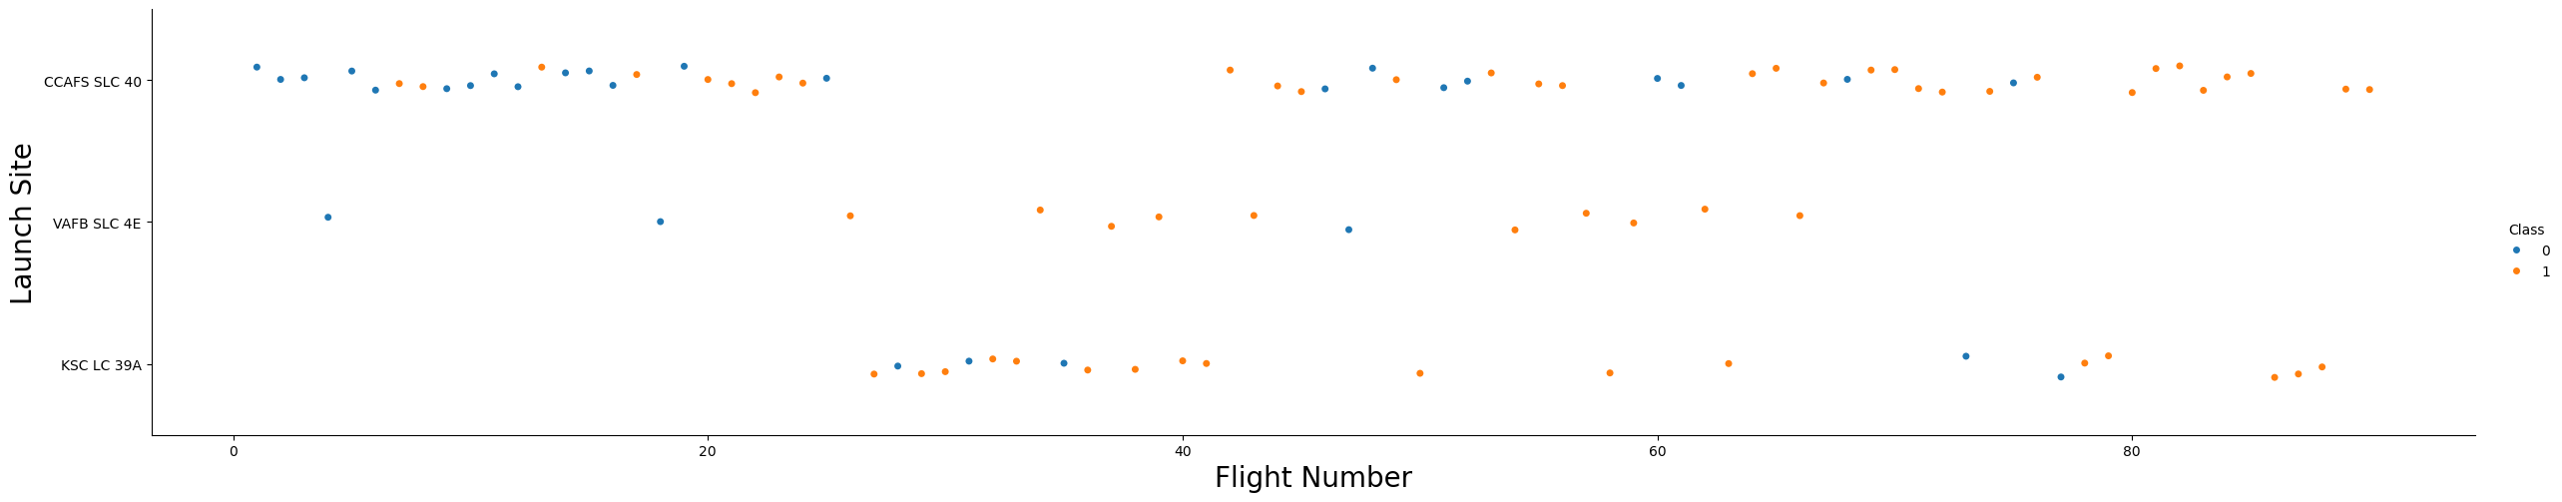
Flight Number vs. Launch Site
Fig. 15: Flight Number vs. Launch SIte
This data reflects SpaceX's evolution from an experimental phase to a highly reliable launch provider.
45

Slide 46
Flight Number vs. Launch Site
Launch Site Usage Patterns:
KSC LC 39A appears to be used primarily for later flights (higher flight numbers), suggesting it became operational later in SpaceX's flight sequence.
CCAFS SLC 40 shows consistent usage across a wide range of flight numbers, indicating it was likely SpaceX's primary launch site for much of their operational history.
VAFB SLC 4E has more limited usage, appearing mainly in specific flight number ranges.
46

Slide 47
Flight Number vs. Launch Site
Success Rate Observations:
CCAFS SLC 40 shows several early failures in the lower flight numbers, but demonstrates significant improvement with predominantly successful launches in later flights, reflecting SpaceX's learning curve
KSC LC 39A shows an excellent success rate, indicating very high reliability for missions launched from this site
VAFB SLC 4E displays a strong success rate with very few failures
47

Slide 48
Flight Number vs. Launch Site
Overall Trends:
There's a dramatic improvement in success rates across all sites as flight numbers increase, clearly showing SpaceX's progression from early developmental challenges to operational excellence.
The concentration of failures in the earlier flight numbers demonstrates the typical learning curve for a new launch provider.
KSC LC 39A's introduction during SpaceX's more mature operational phase explains its consistently high success rate.
By the higher flight numbers, all active launch sites show predominantly successful launches, indicating SpaceX achieved operational reliability across their facilities.
48

Slide 49
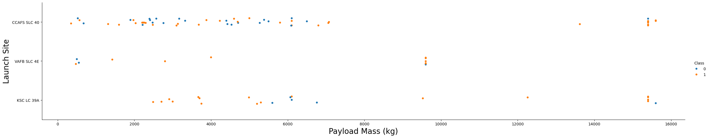
Payload vs. Launch Site
The plot reveals that launch site choice and payload mass both significantly impact landing success, with KSC LC 39A standing out as the most consistent performer.
49

Slide 50
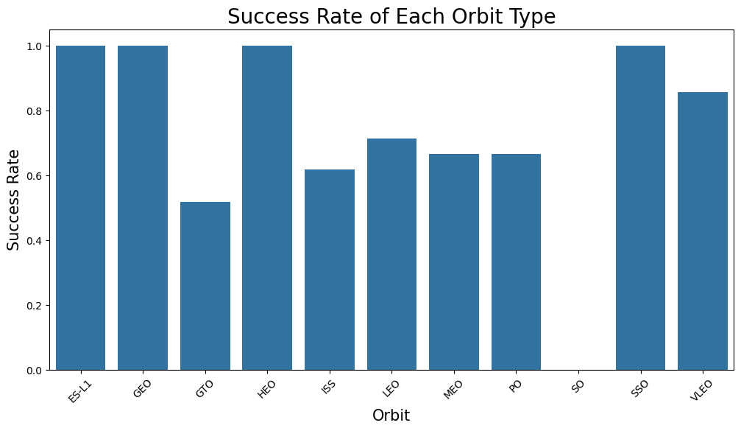
Success Rate vs. Orbit Type
The success rate of first stage landings varies significantly by orbit type, with ES-L1, GEO, HEO, and SSO being the most reliable, and GTO and ISS presenting more challenges. This information is valuable for mission planning and competitive analysis.
50

Slide 51
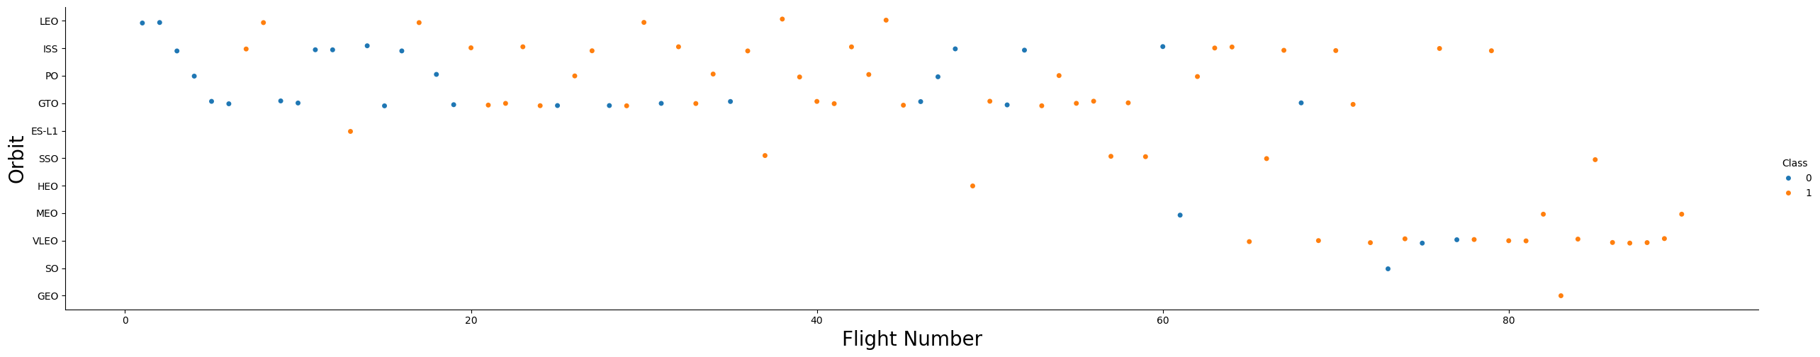
Flight Number vs. Orbit Type
The plot shows SpaceX’s learning curve, with increasing landing success rates over time and improved performance across all orbit types as flight experience grows.
51

Slide 52
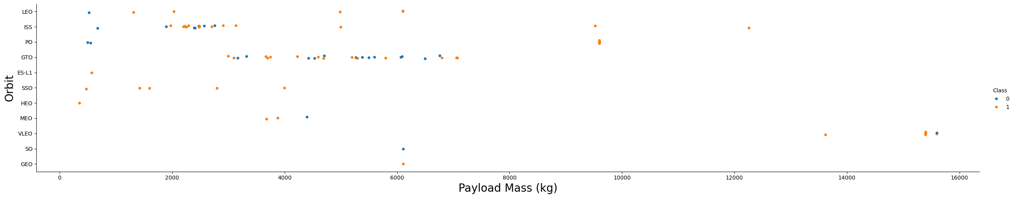
Payload vs. Orbit Type
The plot highlights that lighter payloads and specific orbits (ISS, SSO) are associated with higher landing success rates, while heavier payloads and certain orbits (GTO, GEO) present more challenges for successful landings.
52

Slide 53
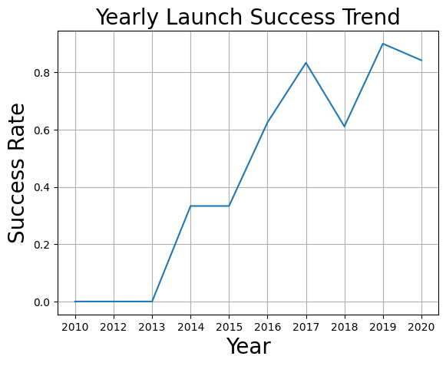
Launch Success Yearly Trend
The trend shows rapid improvement in launch success rates from 2015 onward, with SpaceX achieving near-consistent success by 2019–2020, reflecting advancements in technology and operational experience.
53

Slide 54
All Launch Site Names
This queries are shown and explaind in EDA with SQL (page 28 forward)
54

Slide 55

Section 3

Slide 56
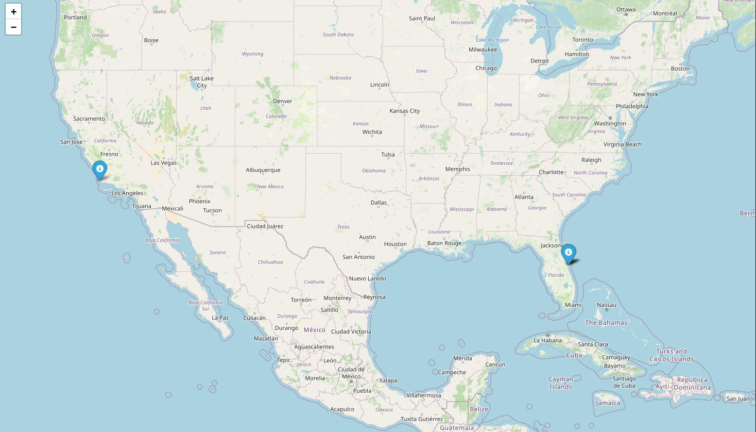
Launch Sites Map Screenshot
The map underscores the strategic placement of SpaceX's launch sites at Vandenberg Air Force Base and Cape Canaveral, each offering unique advantages for different types of missions and orbits. This dual-coast capability enhances SpaceX's operational flexibility and launch cadence.
56

Slide 57

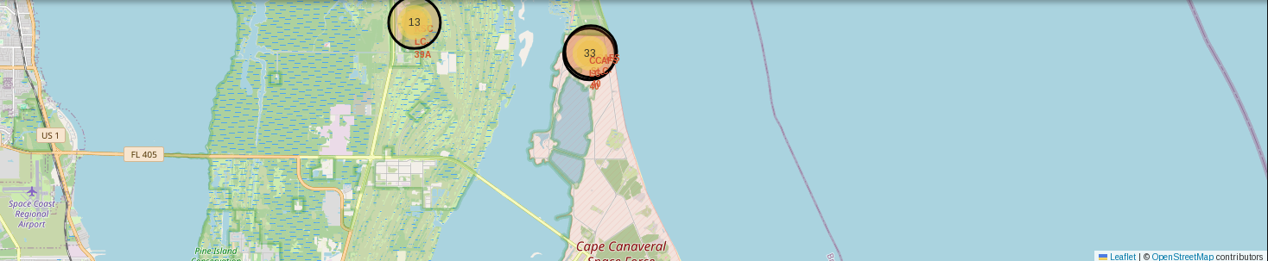
Success/failed launches for each site
57
Vandenberg shows a high success rate for its specific orbit types, while Cape Canaveral, with its higher launch volume and diverse mission types, has a slightly lower but still strong success rate.

Slide 58
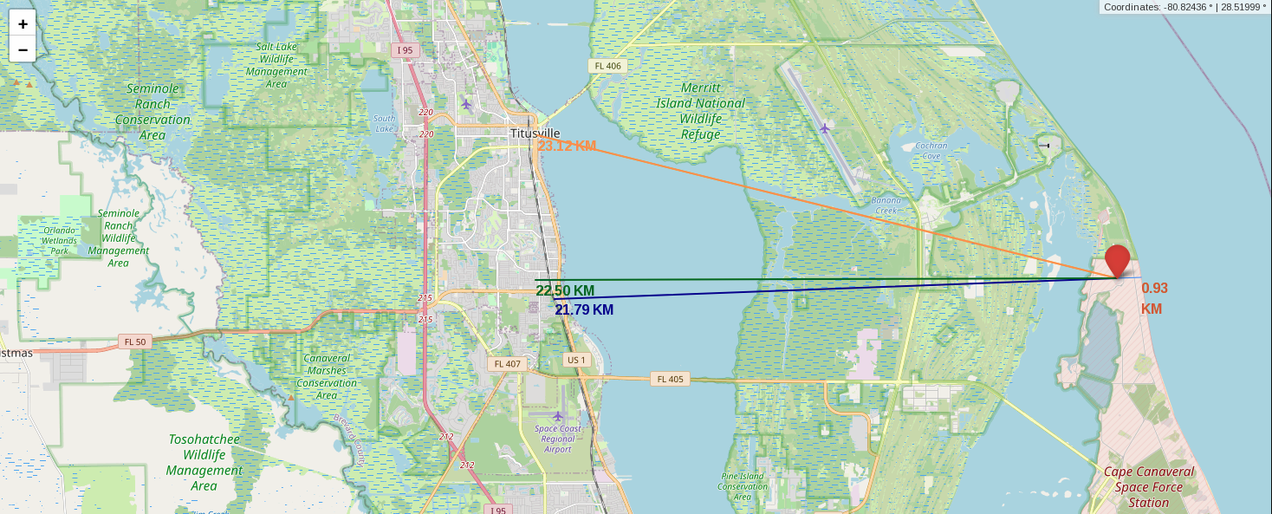
Distances between a launch site to its proximities
The map underscores the strategic location of Cape Canaveral Space Force Station, with its proximity to the coastline and key infrastructure. These elements collectively ensure safe and efficient launch operations.
58

Slide 59

Section 4

Slide 60
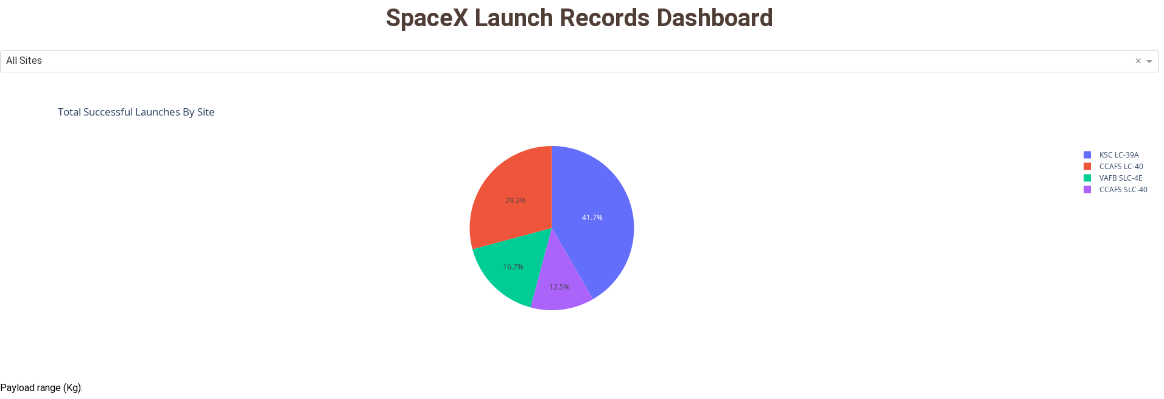
SpaceX Launch Record Dashboard: Launch success count for all sites
The pie chart illustrates the distribution of successful launches across SpaceX's primary launch sites. The dominance of KSC LC-39A and CCAFS SLC-40 underscores their critical role in SpaceX's operations, while VAFB SLC-4E highlights the importance of specialized launch sites for specific orbit types.
60

Slide 61
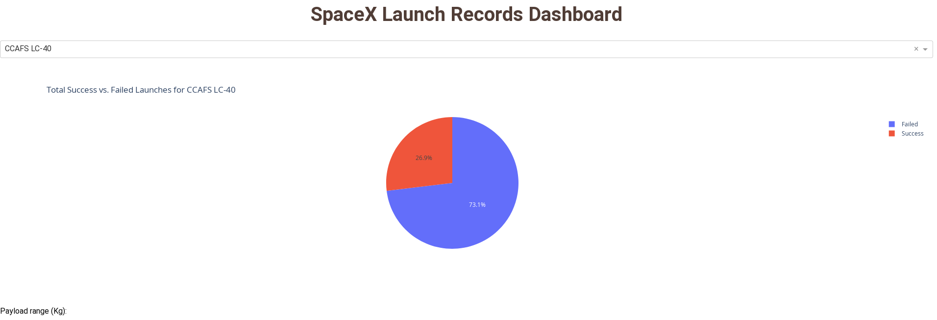
SpaceX Launch Record Dashboard: Site with highest launch success ratio (CCAFS LC-40)
Pie chart for CCAFS LC-40 illustrates a strong success rate of 73.1%, indicating that this launch site is a reliable and crucial asset for SpaceX's operations. The failure rate of 26.9% underscores the complexity and challenges of space launches and the importance of continuous improvement.
61

Slide 62
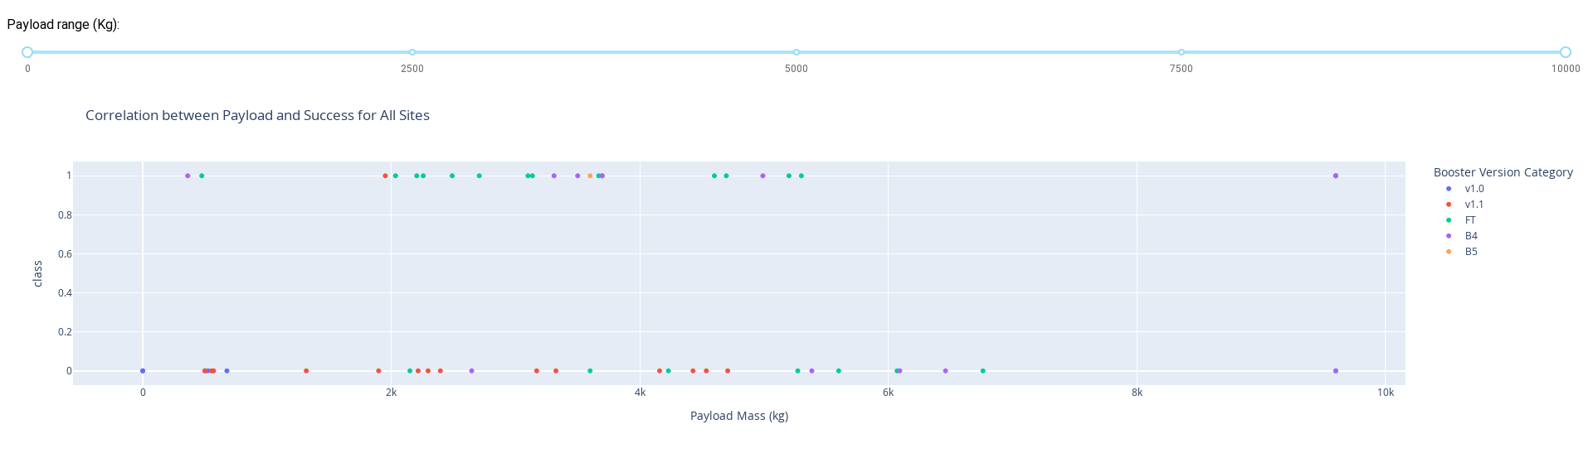
Payload vs. Launch Outcome scatter plot for all sites (different payload in the range slider)
The scatter plot shows the correlation between payload mass, booster version, and launch success. The data shows that newer booster versions (FT, B4, B5) have significantly higher success rates, particularly for heavier payloads.
62

Slide 63

Section 5

Slide 64
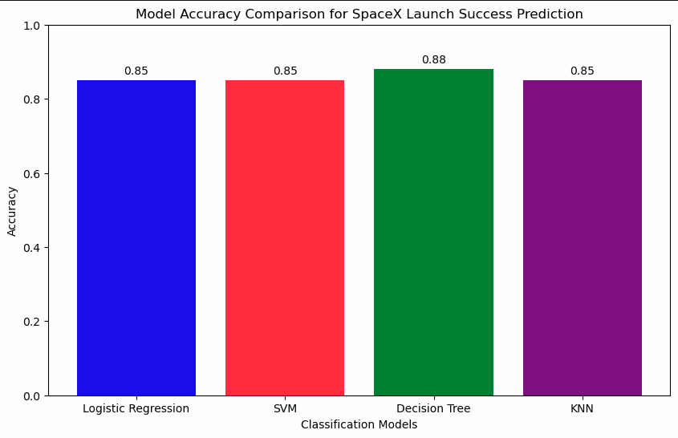
Classification Accuracy
Decission Tree has the highest accuracy: 88%
64

Slide 65
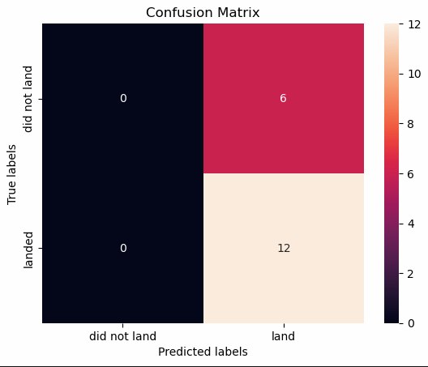
Confusion Matrix: Decission Tree
The confusion matrix shows that the model is very good at identifying successful landings (high recall) but struggles with correctly identifying failed landings (high false positives). Improving the model's ability to distinguish between successful and failed landings will enhance its overall performance.
65

Slide 66
Conclusions
Our project successfully used machine learning to predict SpaceX Falcon 9 first-stage landing outcomes with an accuracy of 0.88.
The Decision Tree Classifier was the most effective model, demonstrating its ability to handle this classification task.
Launch site and payload mass were identified as key factors with a strong correlation to landing success.
Interactive dashboards are a powerful tool for visual data exploration and can provide real-time insights for decision-makers.
<número>

Slide 67
Appendix
Jupyter Notebooks:
1. - jupyter-labs-spacex-data-collection-api.-COMPLETED.ipynb
2. - jupyter-labs-webscraping-COMPLETED.ipynb
3. - labs-jupyter-spacex-Data wrangling-COMPLETED.ipynb
4. - jupyter-labs-eda-sql-coursera_sqllite-COMPLETED.ipynb
5. - edadataviz-COMPLETED.ipynb
6. - lab_jupyter_launch_site_location-COMPLETED.ipynb
7. - SpaceX_Machine Learning Prediction_Part_5-COMPLETED.ipynb
Interactive Dash App: spacex-dash-app-COMPLETED.py
<número>

Slide 68


